Slide 1
Global Coffee Outlook
José Sette
Executive Director
International Coffee Organization

Slide 2
Prices

Slide 3
Composite indicator price (2015-17)

Slide 4
Indicator groups (2015-17)

Slide 5
Demand
side

Slide 6
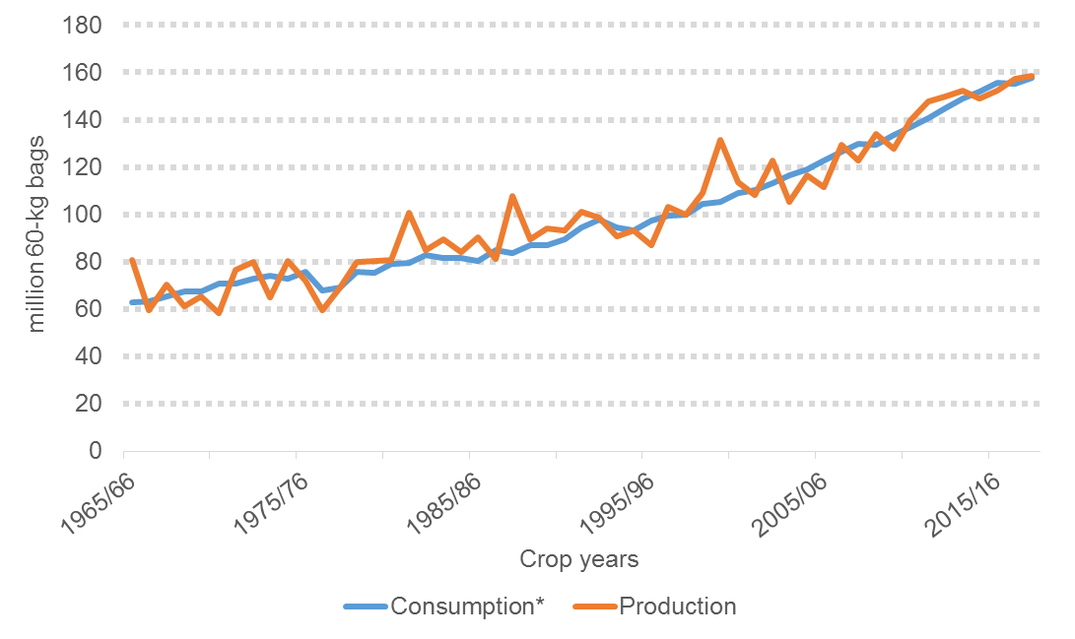
Global demand-supply balance
*Consumption for importing countries on coffee year basis

Slide 7
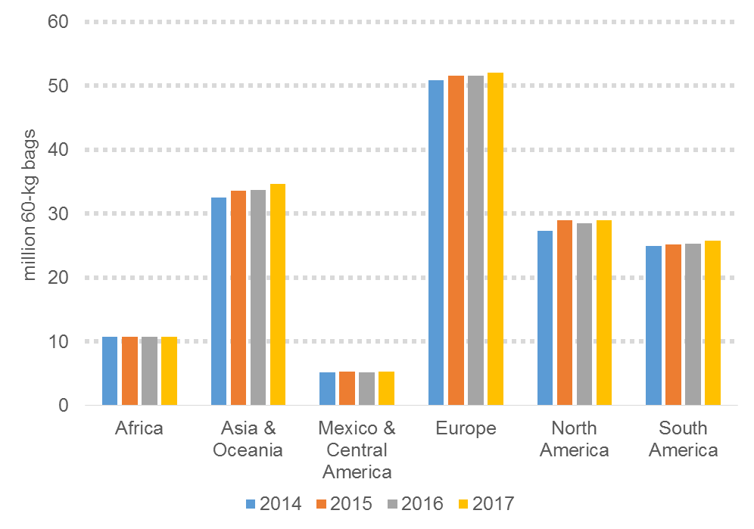
Growth in global demand by region (CAGR)
+0.72%
+2.16%
+1.90%
+1.10%
+0.15%
+0.67%

Slide 8
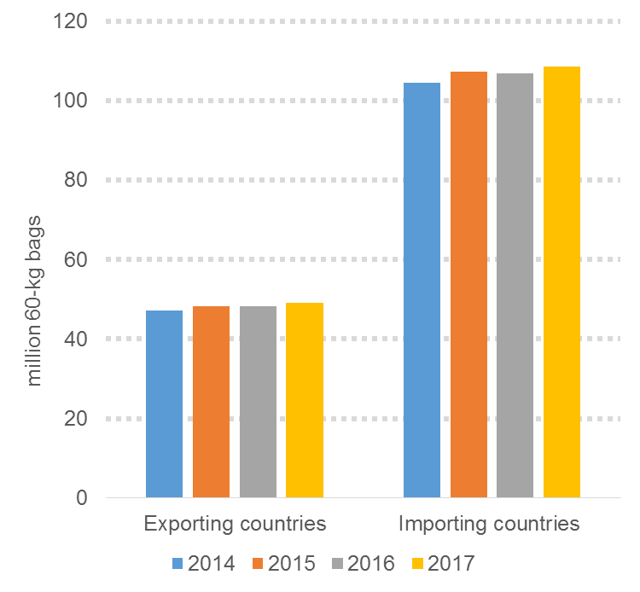
Growth in global demand imp/exp (CAGR)
+1.26%
+1.28%

Slide 9
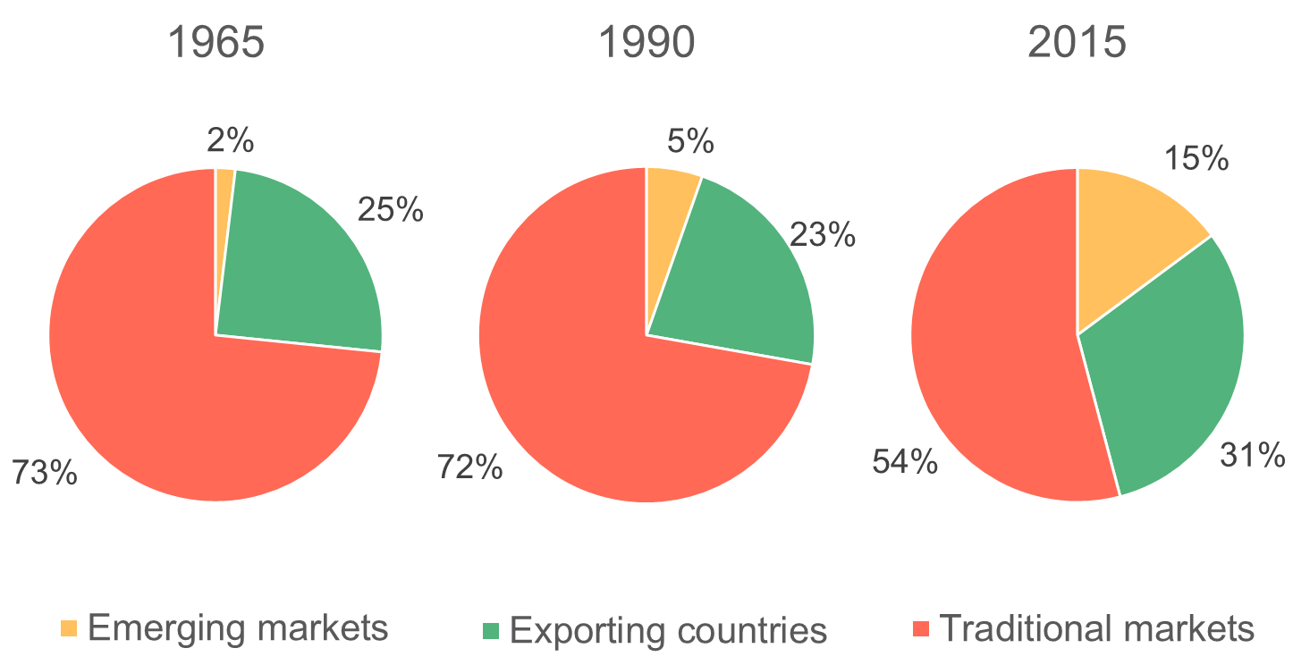
World shares of consumption

Slide 10
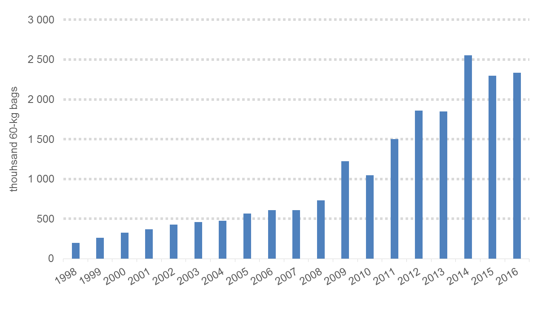
Domestic consumption in China
CAGR 14.7%

Slide 11
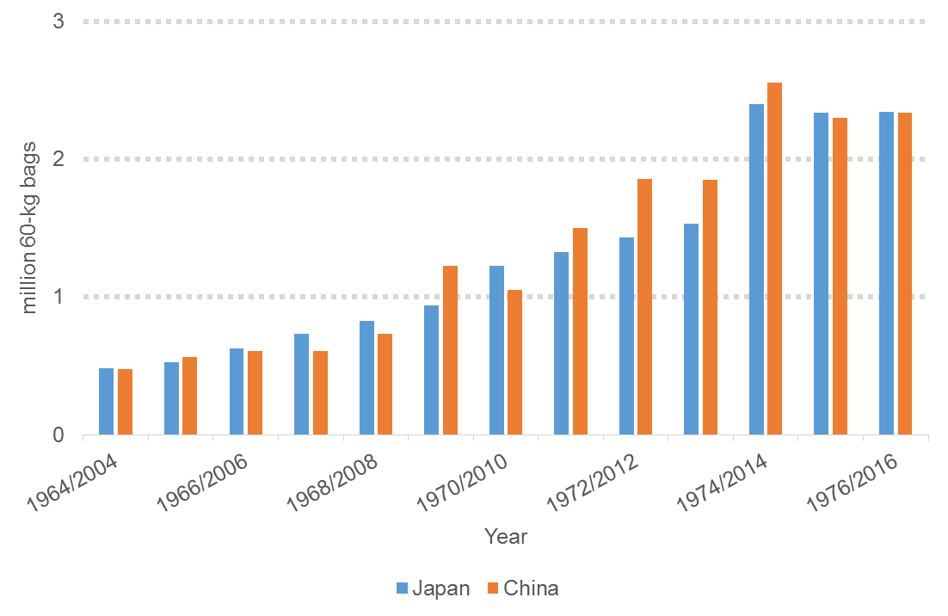
Consumption in China (2004-16) vs. Japan (1964-76)

Slide 12
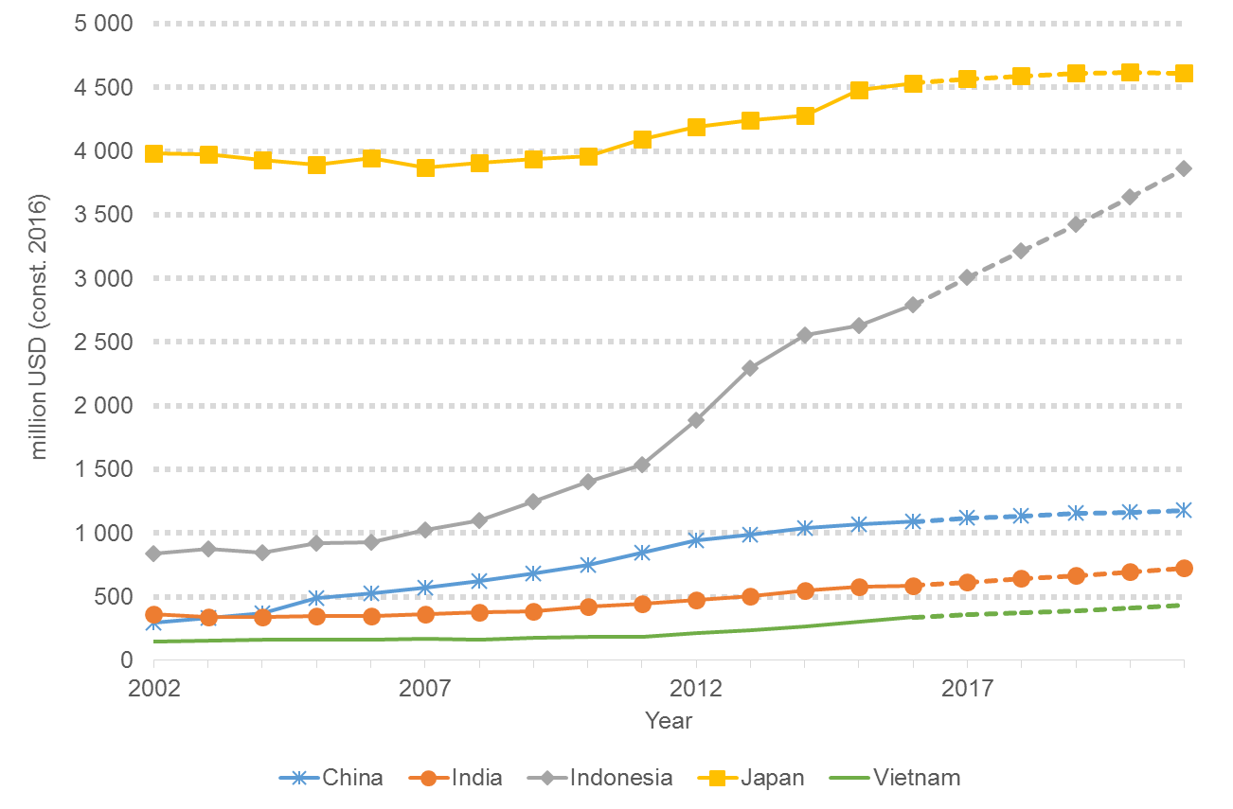
Market size in selected Asian countries
Source: Euromonitor International, Hot Drinks, 2016 Research Edition

Slide 13
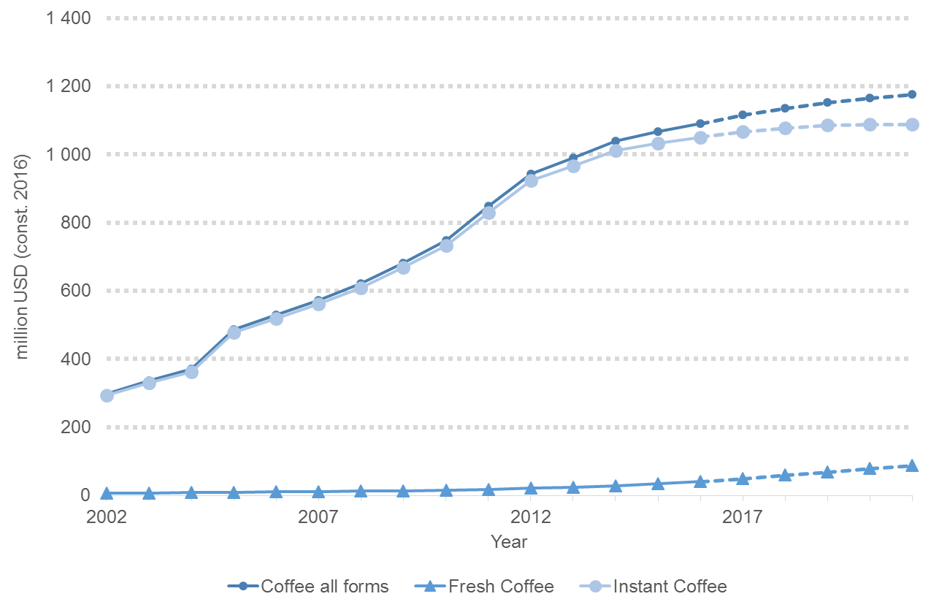
Market size China (by form)
Source: Euromonitor International, Hot Drinks, 2016 Research Edition

Slide 14
Potential for further growth in demand
Large potential for further growth in exporting countries and emerging markets
Per capita rates still well below those in traditional markets
Particularly in countries with large populations (China, India, Indonesia)
Brazil as the model for other countries to emulate (domestic consumption)
kg/capita annually

Slide 15
Supply side

Slide 16
Global demand-supply balance
*Consumption for importing countries on coffee year basis

Slide 17
Global supply by type

Slide 18
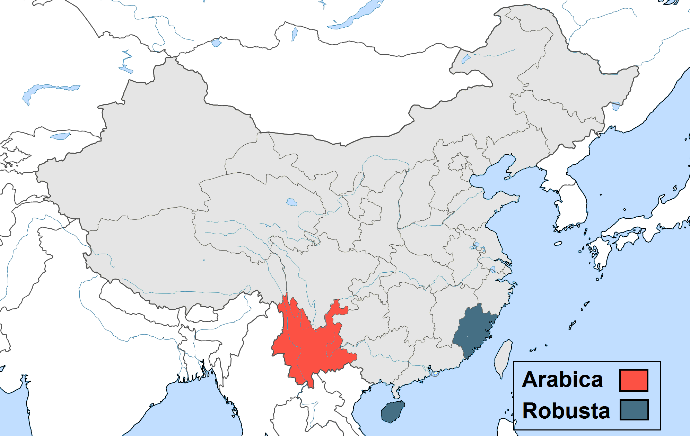
Coffee production in China by type

Slide 19
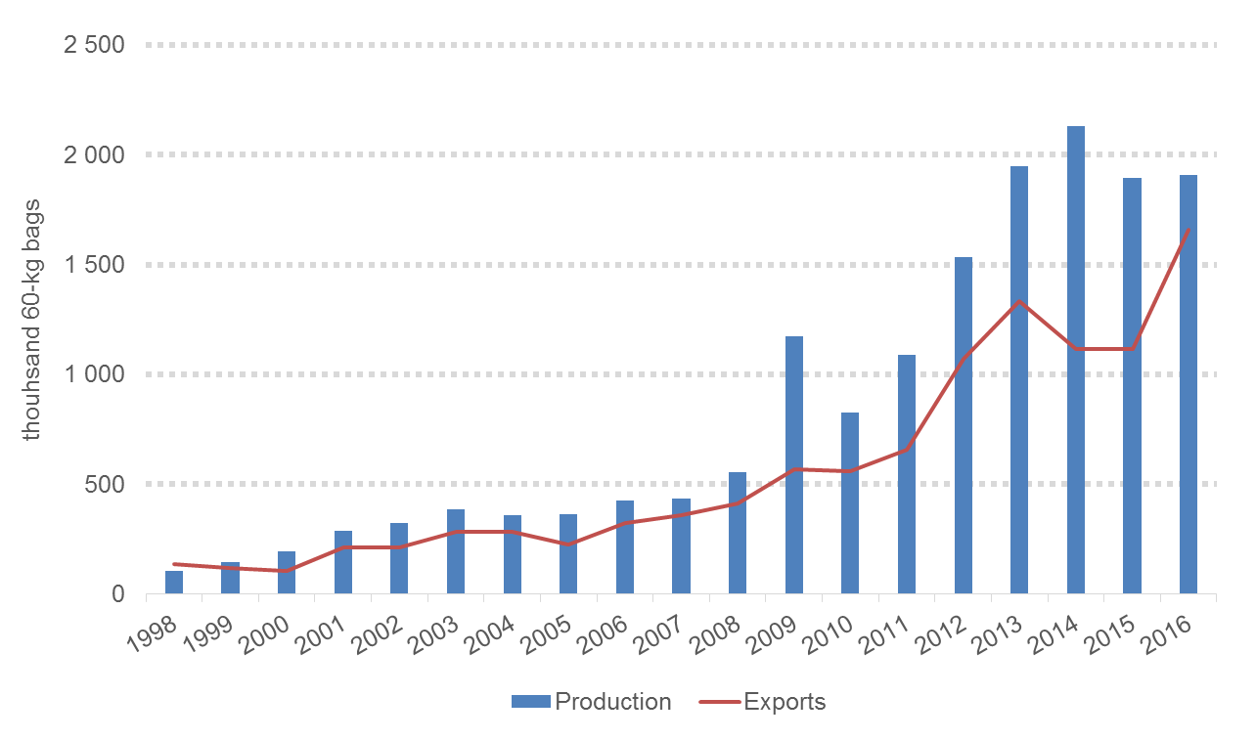
Development of coffee production and exports in China
Production CAGR 14.7%
Exports CAGR 14.7%

Slide 20
Will positive supply trend continue?

Slide 21
Supply gap in 2030?

Slide 22
Global challenges

Slide 23
Sustainability of the coffee sector
A sustainable coffee economy is based on the well-being of all actors in the chain
From a farmer’s point of view:
Meet long term environmental and social goals
AND
Achieve prices that cover production costs
Realise an acceptable profit margin

Slide 24
Climate Change

Slide 25
Impact of climate change on coffee production
Global warming affects coffee production via two pathways
Higher & changes in rainfall patterns temperatures make regions unsuitable for production
Change in climatic conditions facilitates spread of pests and diseases (e.g. Coffee Leaf Rust

Slide 26
Impact of climate change on coffee production (contd.)
Both Arabica and Robusta are negatively affected by climate change
Arabica shows lower yields and lower quality due to higher mean temperatures
Robusta is affected by extreme weather events (especially droughts) in current production areas

Slide 27
Climate change impact on land suitability
Studies project loss in suitability using IPCC emission scenarios (RPC 2.6/ RPC 6.0/ RPC 8.5)
Across scenarios, models predict that 50% of current coffee area will become unsuitable for production
Visualisation of results disaggregated by coffee species

Slide 28
Suitability of current Arabica area in 2050
Source: Bunn et al. 2015

Slide 29
Suitability of current Robusta area in 2050
Source: Bunn et al. 2015

Slide 30
Extreme weather variability led to outbreak of coffee leaf rust in Mesoamerica (2013)
Causes: Rain and temperature variability Humidity: ideal conditions for spores | Impacts: >50% area was impacted by coffee leaf rust Estimated 375,000 jobs lost $500 Mlns in economic loss

Slide 31
Mitigating actions can buffer impact of climate change…
Agronomic techniques and genomic research provides solutions:
Shade trees, mulching
Irrigation where appropriate
Development & dissemination of climate stress tolerant coffee varieties

Slide 32
…but challenges remain…
Coffee is a tree crop → lead times for adaptation measures (e.g. breeding & replanting) are very long
Adaptation at farm level requires investment but producers have limited access to finance

Slide 33
…while migration is not a panacea either
Moving production into higher elevations
Scope varies between countries (e.g. Ethiopia could net-gain 400% production area)
Negative consequences of change in land use patterns need to be considered

Slide 34
Gender equality

Slide 35
Lack of equal opportunities…
Globally, women comprise
20-50% of agricultural labour force
3-20% of landowners
Constrained access to production factors
Systematically lower productivity rates among female-headed households
→ Gender gap

Slide 36
… and much to gain from equality
Closing the gender gap could increase output of by 20 to 30%
Target women through extension programmes
Improve access to finance (financial literacy, training of loan officers)
Women's role in the marketing of cash crops need to be strengthened

Slide 37
Ageing farmers

Slide 38
Generational change in coffee communities
Rural youth is becoming less interested in pursuing a future in farming (especially in African countries)
Lack of opportunities in rural areas (push factors) and labour demand in urban areas (pull factors)
Youth often better educated/more entrepreneurial
Rural-urban migration becomes an important livelihood choice

Slide 39
Why young people are needed
Losing youth as driver of change comes at cost for local communities
Youth more likely to adopt technological innovations (crucial in view of challenges, e.g. climate change)
Lack of a new generation of young growers → supply of high quality coffee beans could be negatively affected

Slide 40
Making coffee farming attractive to young rural dwellers
Increase relative economic viability of growing coffee
Address factors which disproportionally affect young people:
Access to finance (financial literacy, collateral)
Farm succession, rental market for land

Slide 41
The role of the ICO

Slide 42
The ICO’s mission
Strengthen the global coffee sector and promote its sustainable expansion in a market-based environment
Develop a sustainable world coffee sector and to reduce poverty in producing countries

Slide 43
MEMBERSHIP
AS AT OCTOBER 2017
(78 COUNTRIES)

Slide 44
Strategic objectives
Provide a forum for discussion between public and private sector
Collect statistics on the world coffee market (import, export, production, consumption)
Produce market reports & economic studies
Facilitate coffee development projects
Promote coffee quality and consumption

Slide 45
Creating an enabling environment for the coffee sector
Sustainably increase farm productivity through:
Research into improved coffee varieties (e.g. resistance to coffee leaf rust / climate change impact)
Dissemination of new varieties and modern farming techniques (strong institutions, public support for rehabilitation/replanting and extension services)
Access to finance (including long-term loans)

Slide 46
Creating an enabling environment for the coffee sector (contd.)
Enhance farm profitability through:
More efficient supply chains to increase share of FOB price received by farmers
Improving coffee quality to realise premiums
Building domestic consumption base to stabilize demand (volatile markets, currency fluctuations)
Reap dividend of gender equality

Slide 47
Thank you

